Slide 1
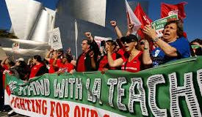
Creating a Social Movement
Increasing Education Funding

Slide 2
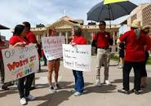
Frame
Increasing education funding for teachers in all learning institutions
Rising costs of living
Funding should be available for all students regardless of the ethnic or racial background
Reducing discrimination in the way funding is done
Access to other advantages by all students and teachers.

Slide 3

K-12 funding remains below the pre-recession levels
That teachers need to continue teaching.
Students need to stay in schools.
Most states had cut the funding for formula one that even the last year boost in funding did not restore funding to precision levels

Slide 4

1. What social movements are available that could fuel your movement at this time?
Despite states increasing high education funding, K-12 funding remains below the precision levels. These has prompted to proceed to protests, strikes and walkouts to state capitals in the previous year to demand for a better pay, better working conditions and benefits. Also, there will be protests this year as well for the same since no changes have been done.

Slide 5

2. What current cultural changes will support your issue and influence your movement?
We are living in a society that has realize the benefits of education.
Students have the right to education, women and girls as well have been the vulnerable population to disparities in education
What about the right for increasing teachers pay so that students can get quality education throughout the year?
We believe in equal opportunities for all the teachers. Other states and countries have considered increasing their teachers pay and thus our teachers as well should be considered.

Slide 6

3. What organizational resources are available for the movement?
Many teachers have started making organizations that they can contribute the little pay they have to make their lives better.
Further, teachers have developed welfare organizations that can take care of them in case of problems.
Students, as well realized the problems that teachers are going through and they are digging deep into their parent’s resources to add teachers an extra income for the extra hours that teachers spend with them.

Slide 7
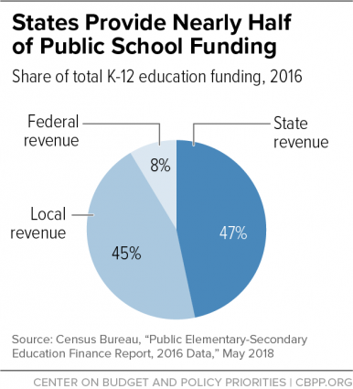
4. What political opportunities can your movement exploit?
Maryland Kirwan Commission on Innovation and Excellence in Education recommended that teachers should be entitled to a 10 percent hike in salary.
The study had identified that teachers get 25 percent less than other comparable professionals with similar capabilities and education.
The amount provided by the states is not enough for teachers pay and thus federal government should intervene.

Slide 8

5. What were the economic issues that may help your movement to catch on?
Teachers cannot afford the basic lifestyle because of the meagre pay.
The state of education can be affected since teachers are not dedicating their maximum time towards teaching students because their salaries are not motivating.
There is less money available for teachers to buy cars and afford a standard living like those of their counterparts with same education and qualification.

Slide 9

Has your issue emerged in your state alone or other states are affected as well?
K-12 funding negotiations have been on-ongoing for long.
Several states are affected, and teacher protests have been witnessed in several states.
The matter in no longer a state issues but rather a federal government issue.

Slide 10
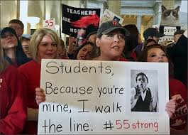
Does the issue have a coalescence in your state
Yes, teachers and students are suffering all together because the plight of students independent on the teacher's well-being.

Slide 11
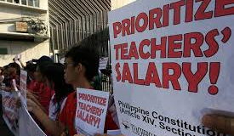
If not, how might the issue get to the coalescence stage
Despite the issue being at the coalescence stage, there is still a lot that needs to be done.
Different stakeholders need to come together the end the problems surrounding the teachers pay.
Other professionals are paid well but only teachers are still suffering. Labor Acts need to be formulated to ensure that teachers enjoy as other civil servants.

Slide 12
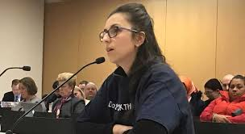
Has your issue reached formalization?
Reaching formalization in this issues requires heated debates addressing the plight of teachers.
After all stakeholders have realized the essence of our social movement, they will accept the reasons as to why we need a salary raise.
As I said, formalization cannot be reached from one state while other states are still behind in addressing teacher issues.
Once the federal government addresses this issue, then it could be good to say we have reached formalization.

Slide 13
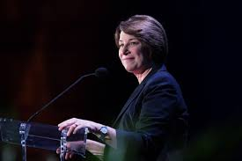
What would success look like for your issue in the country?
Our movement will be successful if as a pilot project, teachers' salaries are increased.
The salaries become comparable to that of other civil servants
If the teachers will be able to afford a decent living style from the salaries.
If the teachers can comfortably drive cars of their choices like other civil servants of the same qualification.

